Slide 1
Introduction to Information Retrieval
Hongning Wang
CS@UVa

Slide 2
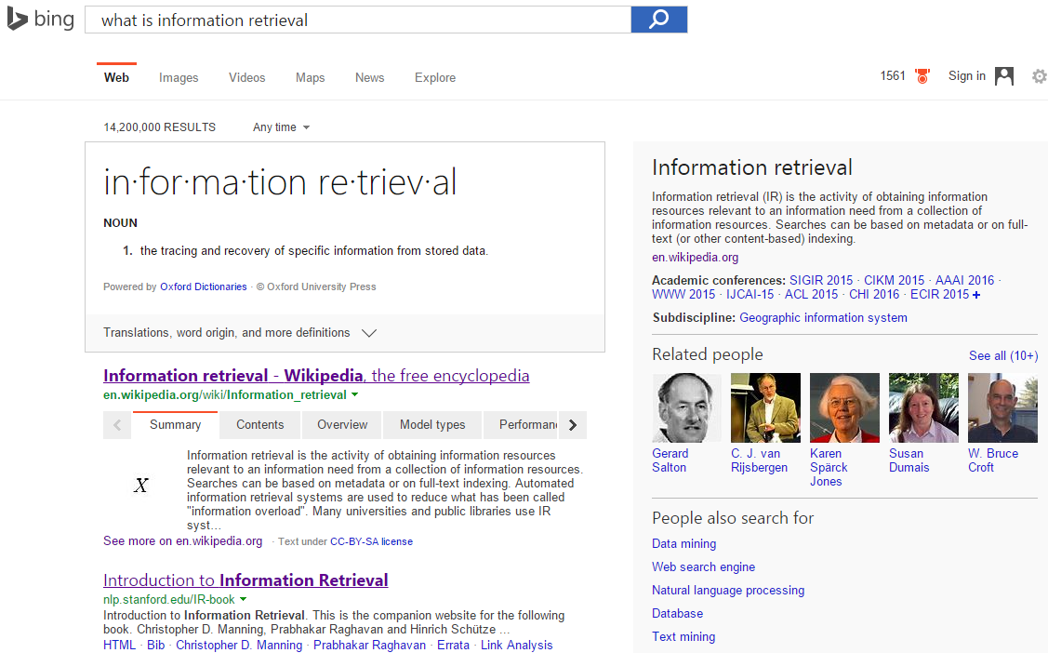
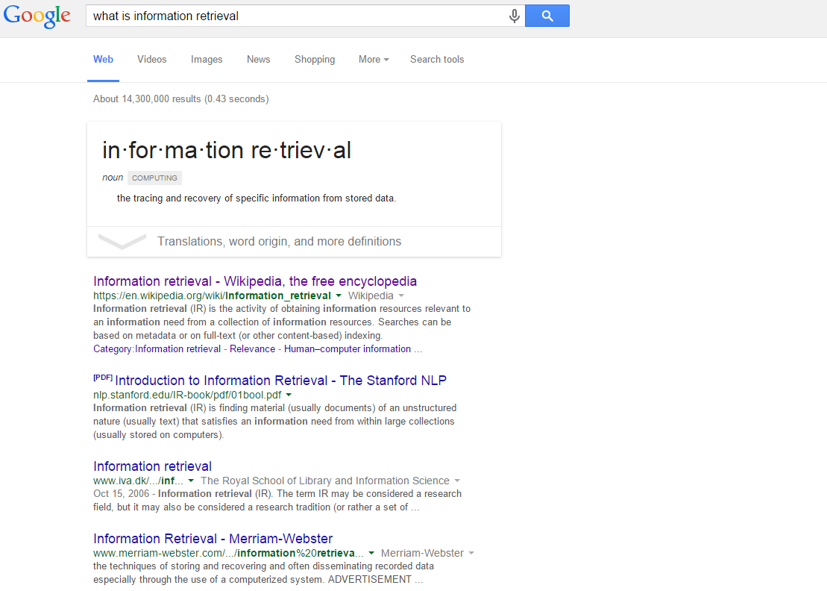
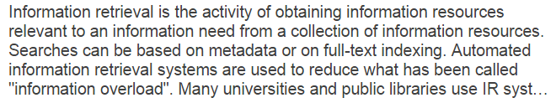
What is information retrieval?

Slide 3
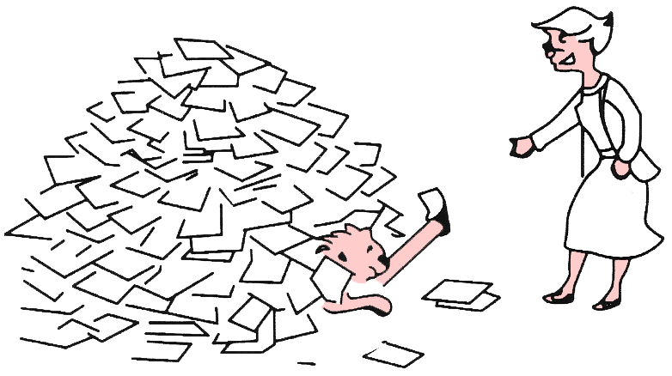
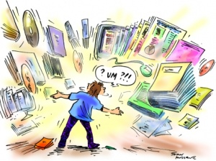
Why information retrieval
Information overload
“It refers to the difficulty a person can have understanding an issue and making decisions that can be caused by the presence of too much information.” - wiki

Slide 4
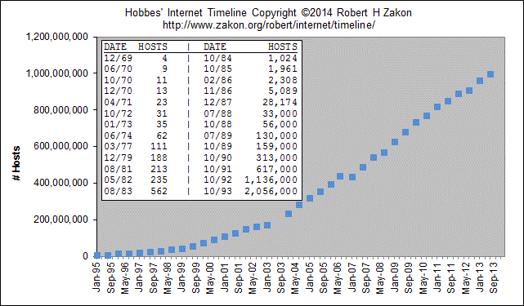
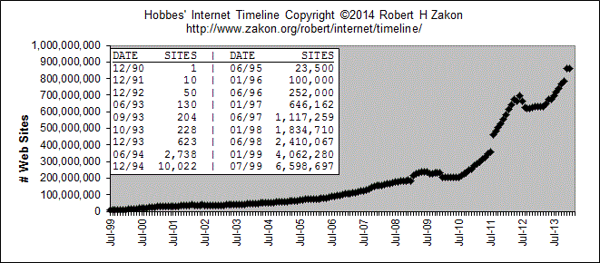
Why information retrieval
Information overload
Figure 2: Growth of WWW
Figure 1: Growth of Internet

Slide 5
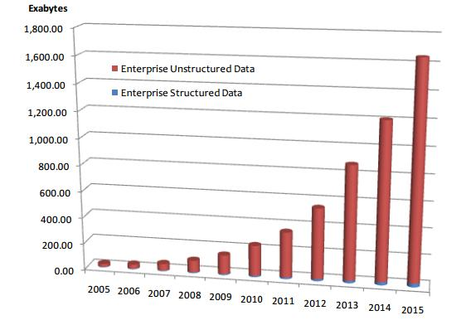
Why information retrieval
Handling unstructured data
Structured data: database system is a good choice
Unstructured data is more dominant
Text in Web documents or emails, image, audio, video…
“85 percent of all business information exists as unstructured data” - Merrill Lynch
Unknown semantic meaning
Table 1: People in CS Department
ID | Name | Job
1 | Jack | Professor
3 | David | Stuff
5 | Tony | IT support
Total Enterprise Data Growth 2005-2015, IDC 2012

Slide 6
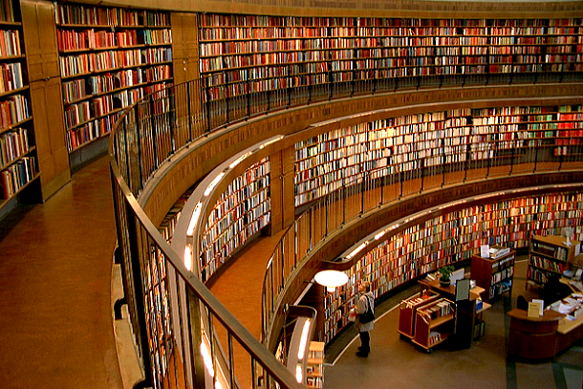
Why information retrieval
An essential tool to deal with information overload
You are here!

Slide 7
History of information retrieval
Idea popularized in the pioneer article “As We May Think” by Vannevar Bush, 1945
“Wholly new forms of encyclopedias will appear, ready-made with a mesh of associative trails running through them, ready to be dropped into the memex and there amplified.”
“A memex is a device in which an individual stores all his books, records, and communications, and which is mechanized so that it may be consulted with exceeding speed and flexibility.”
-> WWW
-> Search engine

Slide 8
Major research milestones
Early days (late 1950s to 1960s): foundation of the field
Luhn’s work on automatic indexing
Cleverdon’s Cranfield evaluation methodology and index experiments
Salton’s early work on SMART system and experiments
1970s-1980s: a large number of retrieval models
Vector space model
Probabilistic models
1990s: further development of retrieval models and new tasks
Language models
TREC evaluation
Web search
2000s-present: more applications, especially Web search and interactions with other fields
Learning to rank
Scalability (e.g., MapReduce)
Real-time search

Slide 9
History of information retrieval
Catalyst
Academia: Text Retrieval Conference (TREC) in 1992
“Its purpose was to support research within the information retrieval community by providing the infrastructure necessary for large-scale evaluation of text retrieval methodologies.”
“… about one-third of the improvement in web search engines from 1999 to 2009 is attributable to TREC. Those enhancements likely saved up to 3 billion hours of time using web search engines.”
Till today, it is still a major test-bed for academic research in IR

Slide 10
History of information retrieval
Catalyst
Industry: web search engines
WWW unleashed explosion of published information and drove the innovation of IR techniques
First web search engine: “Oscar Nierstrasz at the University of Geneva wrote a series of Perl scripts that periodically mirrored these pages and rewrote them into a standard format.” Sept 2, 1993
Lycos (started at CMU) was launched and became a major commercial endeavor in 1994
Booming of search engine industry: Magellan, Excite, Infoseek, Inktomi, Northern Light, AltaVista, Yahoo!, Google, and Bing

Slide 11
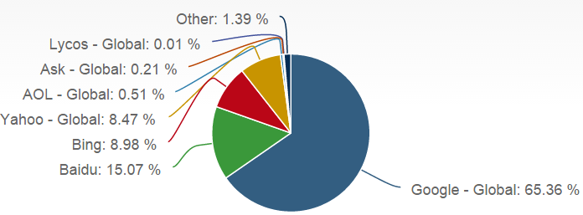
Major players in this game
Global search engine market - desktop
By http://marketshare.hitslink.com/search-engine-market-share.aspx

Slide 12
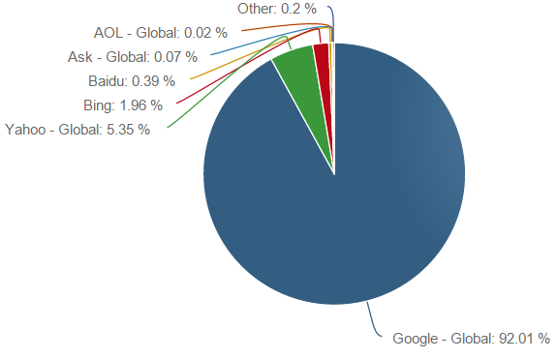
Major players in this game
Global search engine market - mobile
By http://marketshare.hitslink.com/search-engine-market-share.aspx

Slide 13
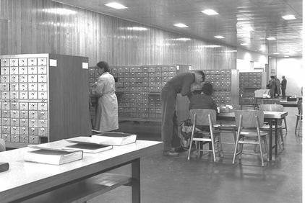
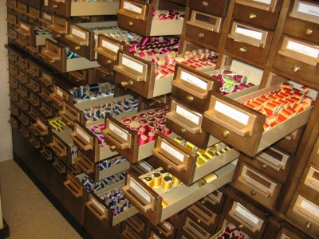
How to perform information retrieval
Information retrieval when we did not have a computer

Slide 14
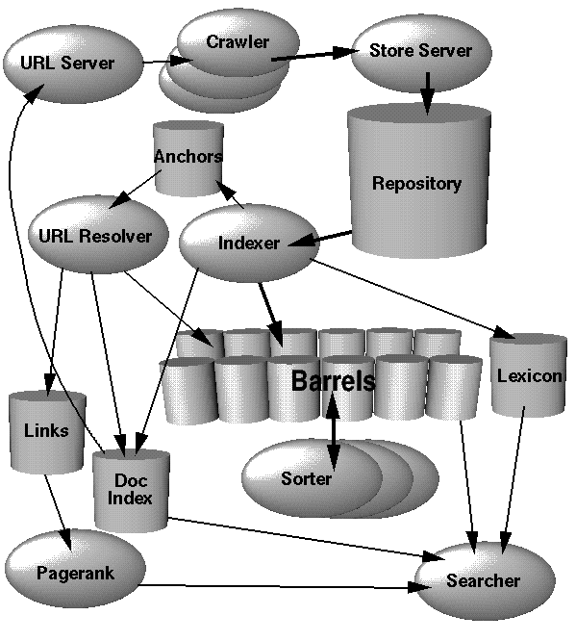
How to perform information retrieval
Crawler and indexer
Query parser
Ranking model
Document Analyzer

Slide 15
How to perform information retrieval
PARSING & INDEXING
Doc
Rep
Query
Rep
query
User
Repository
Ranking
SEARCH
results
APPLICATIONS
LEARNING
Evaluation
judgments
FEEDBACK
We will cover:
1) Search engine architecture; 2)Retrieval models;
3) Retrieval evaluation; 4) Relevance feedback;
5) Link analysis; 6) Search applications.

Slide 16
Core concepts in IR
Query representation
Lexical gap: say v.s. said
Semantic gap: ranking model v.s. retrieval method
Document representation
Specific data structure for efficient access
Lexical gap and semantic gap
Retrieval model
Algorithms that find the most relevant documents for the given information need

Slide 17
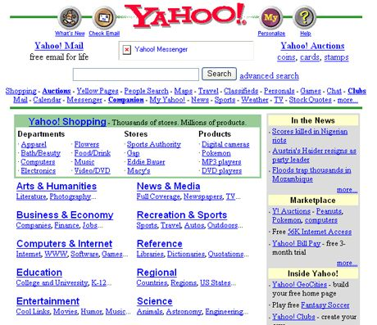
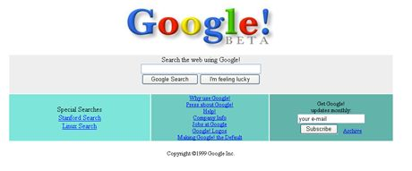
A glance of modern search engine
Yet Another Hierarchical Officious/Obstreperous/ Odiferous/Organized Oracle
In old times

Slide 18
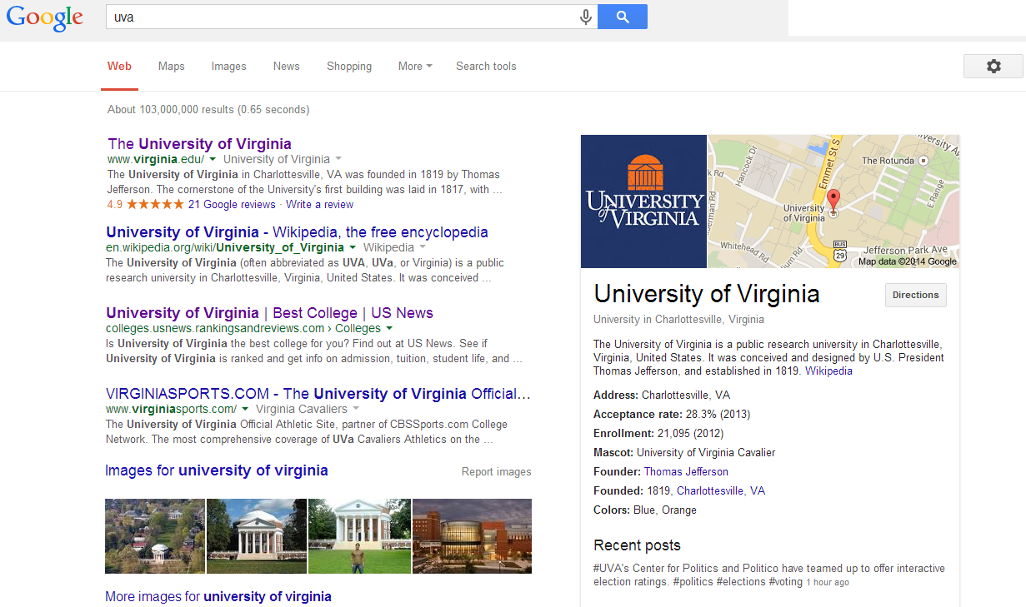

A glance of modern search engine
Demand of understanding
Modern time
Demand of efficiency
Demand of convenience
Demand of accuracy
Demand of diversity

Slide 19

IR is not just about web search
Web search is just one important area of information retrieval, but not all
Information retrieval also includes
Recommendation

Slide 20
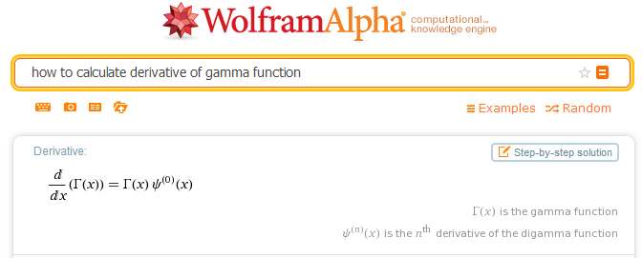
IR is not just about web search
Web search is just one important area of information retrieval, but not all
Information retrieval also includes
Question answering

Slide 21
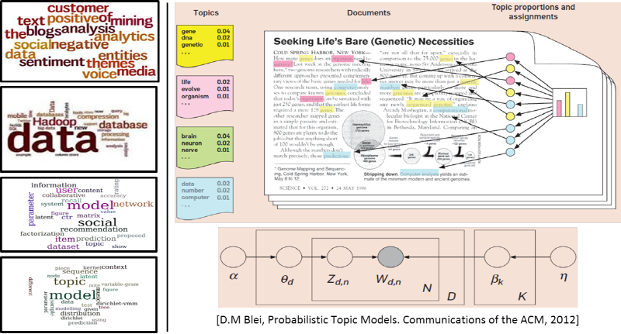
IR is not just about web search
Web search is just one important area of information retrieval, but not all
Information retrieval also includes
Text mining

Slide 22
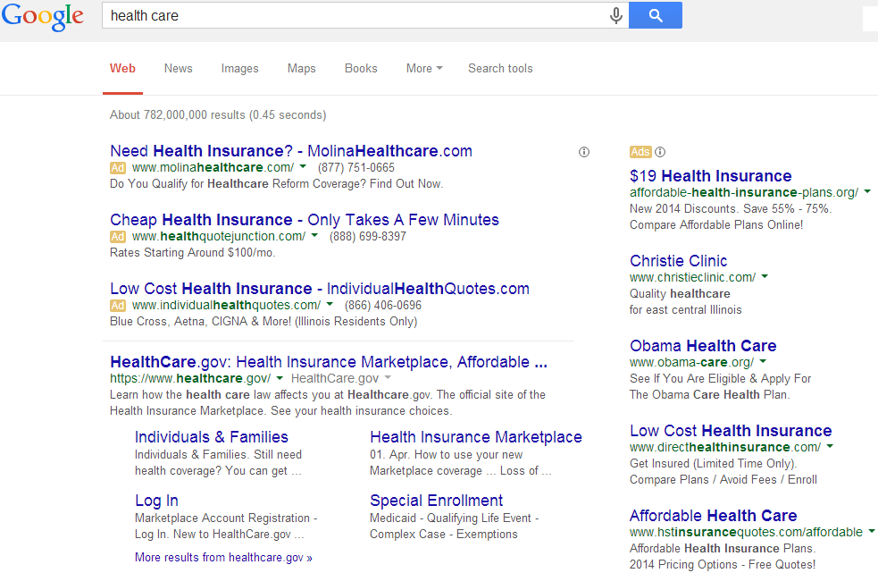
IR is not just about web search
Web search is just one important area of information retrieval, but not all
Information retrieval also includes
Online advertising

Slide 23
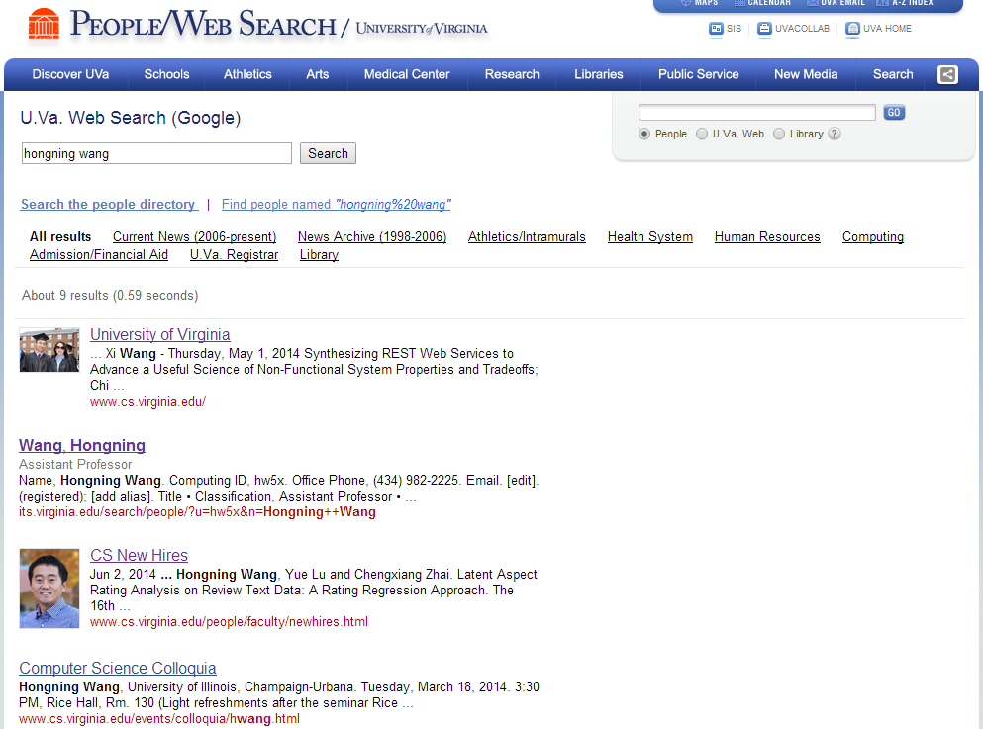
IR is not just about web search
Web search is just one important area of information retrieval, but not all
Information retrieval also includes
Enterprise search: web search + desktop search

Slide 24
Recap: what is information retrieval

Slide 25
Recap: why information retrieval
Information overload
Too much information to process
Handling unstructured data
Unknown semantic meaning

Slide 26
Recap: history of information retrieval
“As We May Think” by Vannevar Bush, 1945
WWW and search engine
Early days (late 1950s to 1960s): automatic indexing
1970s-1980s: retrieval models
1990s: TREC evaluation and Web search
2000s-present: more applications

Slide 27
Recap: IR architecture
PARSING & INDEXING
Doc
Rep
Query
Rep
query
User
Repository
Ranking
SEARCH
results
APPLICATIONS
LEARNING
Evaluation
judgments
FEEDBACK
We will cover:
1) Search engine architecture; 2)Retrieval models;
3) Retrieval evaluation; 4) Relevance feedback;
5) Link analysis; 6) Search applications.

Slide 28
Recap: IR is not just web search
Recommendation
Netflix, Pandora
Question answering
Wolfram Alpha
Text mining
Topic modeling, sentiment analysis
Online advertisement
Behavior targeting, monetization

Slide 29
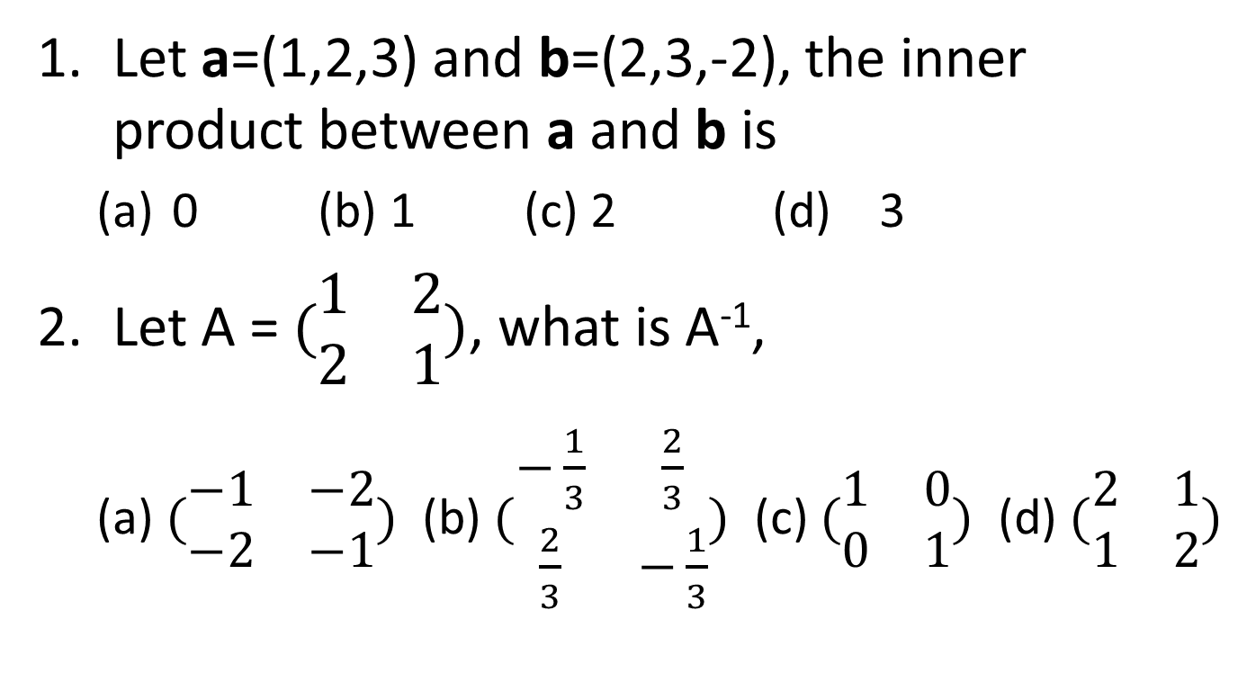
Pop-up quiz
Let a=(1,2,3) and b=(2,3,-2), the inner product between a and b is
0 (b) 1 (c) 2 (d) 3
Let A = $(\begin{matrix}1 & 2 \\ 2 & 1\end{matrix})$, what is A⁻¹,
(a) $(\begin{matrix}−1 & −2 \\ −2 & −1\end{matrix})$ (b) $(\begin{matrix}−\frac{1}{3} & \frac{2}{3} \\ \frac{2}{3} & −\frac{1}{3}\end{matrix})$ (c) $(\begin{matrix}1 & 0 \\ 0 & 1\end{matrix})$ (d) $(\begin{matrix}2 & 1 \\ 1 & 2\end{matrix})$

Slide 30
Pop-up quiz
What is the expectation of random variables drawn from Gaussian distribution N(0, 1),
0 (b) 0.5 (c) 1 (d) 2
A biased coin with P(head)=0.2, in a sequence of 10 consecutive tossing, you have already got 9 tails, what is the probability you have a head at the 10th tossing,
(a) 0 (b) 0.1 (c) 0.2 (d) 0.2*0.8⁹

Slide 31
Pop-up quiz
Let a=(1,2,3) and b=(2,3,-2), the inner product between a and b is
0 (b) 1 (c) 2 (d) 3
Let A = $(\begin{matrix}1 & 2 \\ 2 & 1\end{matrix})$, what is A⁻¹,
(a) $(\begin{matrix}−1 & −2 \\ −2 & −1\end{matrix})$ (b) $(\begin{matrix}−\frac{1}{3} & \frac{2}{3} \\ \frac{2}{3} & −\frac{1}{3}\end{matrix})$ (c) $(\begin{matrix}1 & 0 \\ 0 & 1\end{matrix})$ (d) $(\begin{matrix}2 & 1 \\ 1 & 2\end{matrix})$
(c)
(b)

Slide 32
Pop-up quiz
What is the expectation of random variables drawn from Gaussian distribution N(0, 1),
0 (b) 0.5 (c) 1 (d) 2
A biased coin with P(head)=0.2, in a sequence of 10 consecutive tossing, you have already got 9 tails, what is the probability you have a head at the 10th tossing,
(a) 0 (b) 0.1 (c) 0.2 (d) 0.2*0.8⁹
(a)
(c)
(d)

Slide 33
Related Areas
Applications
Mathematics
Web Applications,
Bioinformatics…
Machine Learning
Pattern Recognition
Library & Info
Science
Information
Retrieval
Natural
Language
Processing
Statistics
Optimization
Databases
Data Mining
Software engineering
Computer systems
Algorithms
Systems

Slide 34
IR v.s. DBs
Information Retrieval:
Unstructured data
Semantics of objects are subjective
Simple keyword queries
Relevance-drive retrieval
Effectiveness is primary issue, though efficiency is also important
Database Systems:
Structured data
Semantics of each object are well defined
Structured query languages (e.g., SQL)
Exact retrieval
Emphasis on efficiency

Slide 35
IR and DBs are getting closer
IR => DBs
Approximate search is available in DBs
Eg. in mySQL
DBs => IR
Use information extraction to convert unstructured data to structured data
Semi-structured representation: XML data; queries with structured information
mysql> SELECT * FROM articles
-> WHERE MATCH (title,body)
AGAINST ('database');

Slide 36
IR v.s. NLP
Information retrieval
Computational approaches
Statistical (shallow) understanding of language
Handle large scale problems
Natural language processing
Cognitive, symbolic and computational approaches
Semantic (deep) understanding of language
(often times) small scale problems

Slide 37
IR and NLP are getting closer
IR => NLP
Larger data collections
Scalable/robust NLP techniques, e.g., translation models
NLP => IR
Deep analysis of text documents and queries
Information extraction for structured IR tasks

Slide 38
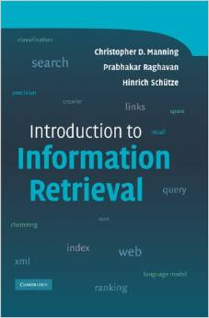
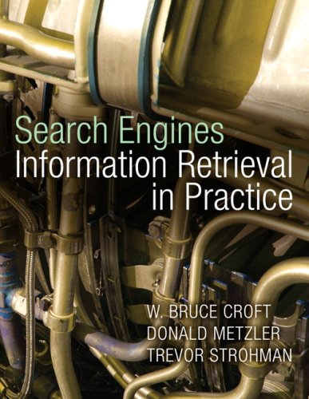
Text books
Introduction to Information Retrieval. Christopher D. Manning, Prabhakar Raghavan, and Hinrich Schuetze, Cambridge University Press, 2007.
Search Engines: Information Retrieval in Practice. Bruce Croft, Donald Metzler, and Trevor Strohman, Pearson Education, 2009.

Slide 39

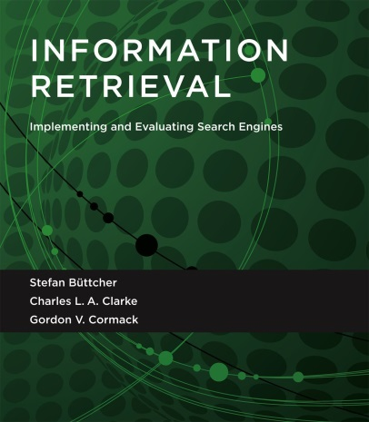
Text books
Modern Information Retrieval. Ricardo Baeza-Yates and Berthier Ribeiro-Neto, Addison-Wesley, 2011.
Information Retrieval: Implementing and Evaluating Search Engines. Stefan Buttcher, Charlie Clarke, Gordon Cormack, MIT Press, 2010.

Slide 40
What to read?
Applications
Mathematics
Web Applications,
Bioinformatics…
Machine Learning
Pattern Recognition
Library & Info
Science
ICML, NIPS, UAI
Information Retrieval
Statistics
Optimization
NLP
SIGIR, WWW, WSDM, CIKM
Databases
ACL, EMNLP, COLING
SIGMOD, VLDB, ICDE
Data Mining
Software engineering
Computer systems
KDD, ICDM, SDM
Algorithms
Systems
Find more on course website for resource

Slide 41
IR in future
Mobile search
Desktop search + location? Not exactly!!
Interactive retrieval
Machine collaborates with human for information access
Personal assistant
Proactive information retrieval
Knowledge navigator
And many more
You name it!

Slide 42
What you should know
IR originates from library science for handling unstructured data
IR has many important application areas, e.g., web search, recommendation, and question answering
IR is a highly interdisciplinary area with DBs, NLP, ML, HCI

Slide 43
Today’s reading
Bush, Vannevar. "As we may think." The atlantic monthly 176, no.1 (1945): 101-108.
Introduction to Information Retrieval
Chapter 1: Boolean Retrieval

